Slide 1
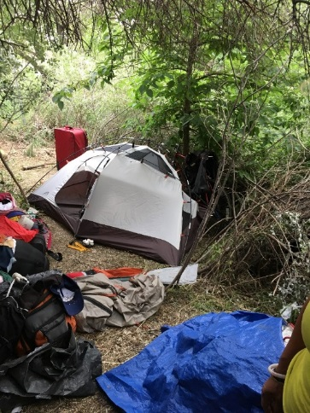
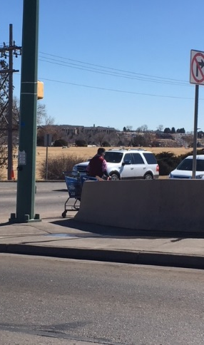
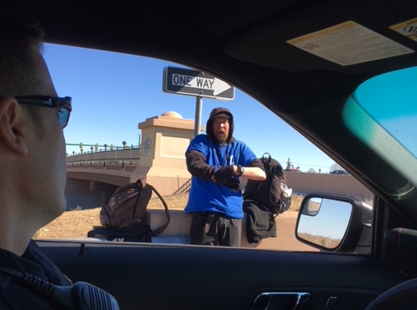
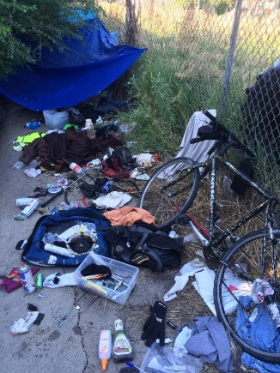
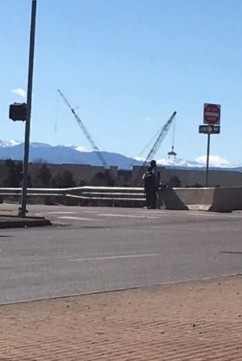
How can you be part of the Solution?
City of Northglenn
Notes:
Why are we here today? To discuss some of the concerns that have come to light over the last few years with how to help find a solution to the increasing Homeless issues found in our community.

Slide 2
City of Northglenn Task Force
-City Management
-City Attorney
-Police Department
-Municipal Court
-Code Enforcement
-Parks Department
-Public Works Department
-Human Resources/Risk Management
Who is impacted?
What are the impacts?
How can we help mitigate the problems?
Notes:
Over the last several months the City of Northglenn Staff has formed a Task Force to discuss solutions to the every growing concerns over the increasing homless population in and around Northglenn.
This problem has become much more extensive since 2015-2016 when the City of Denver began pushing the Transient Populations out of Downtown Denver and into the surrounding suburbs. The legalization of marijuana and exploding housing market has also contributed to this increase.

Slide 3
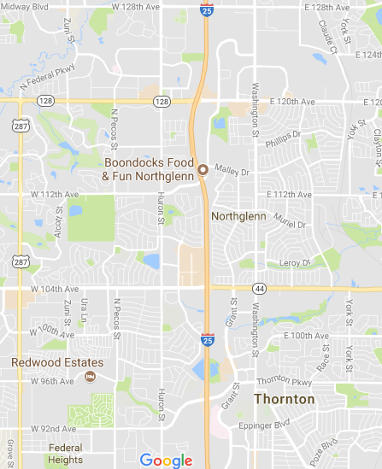
Transient Appeal
Attracted to the Interstate Interchanges
120th & 104th Ave, and Malley Drive
Attracted to the retail shopping areas
Established Transient Encampment Sites
Ramada Inn (North Parking Lot)
Highline Canal (120th Ave.-Webster Lake)
Grange Ditch (south of Northglenn Ambulance)
104th Ave & I-25 (behind the Northglenn sign)
Croke Reservoir
Notes:
In our contact with many of these Transients, Police Officers have been told many of the reasons why they land in Northglenn are because of the I-25 interchanges, retail shopping and food centers, and accessibility of homeless camps. Additionally, some of them have come form the recreational marijuana in Colorado and proximity of liquor stores to these “money making” sites. There are also RTD bus stops that make their last stops of the day in Northglenn which lead to many of them staying in our area during the night time hours.
The City of Denver has recently been trying to clean up their homeless encampments which have thrusted many of them into the suburban jurisdictions. Commerce City, Thornton, and Adams County as a whole have also seen spike in their populations over the last few years and have even created special units and spent thousands of dollars trying to combat the problems particularly along the Platte River drainage.

Slide 4
“Transient” Reporting 2010-2017
2017 = 96
2016 = 96
2015 = 64
2014 = 48
2013 = 43
2012 = 42
2011 = 27
2010 = 30
Notes:
In our Police Records Management system there has been a noticeable increase in the number of reports involving “transient” citizens.

Slide 5
The “Debate” Over Transient Populations
Choice vs. Circumstance
Victims vs. Offenders
Punitive vs. Assistance
Helping vs. Enabling
Notes:
Dealing with these populations can be fraught with moral dangers and spark significant debate for the public services, private sector and community at large which is why the strategies to deal with these problems needs to be carefully crafted. The City must consider the public perception and special interest group backlash for any strategy they select to combat these issues.

Slide 6
Impact to the Community
Transient Populations Itself
Fear & Intimidation to the Community at Large
Loss of Business & Customers
Increased Work Load for Police, EMS, Hospitals and Maintenance Personnel
Public Health & Safety
Notes:
Over the last two years the North Metro Area has seen an increase Transient Populations and the Police Department has identified close to 200 individuals identified as Transients. We have also talked with local business owners, citizens and other Public Service providers that have seen an increase in their Transient related calls for service.
One local business owner recently stated they will move their business from the Safeway Shopping Center when her lease expires unless something is done about the transients because they are driving away her business and her customers don’t feel safe. She expressed that the chronic intoxication, defecation, urination, drug and prostitution concerns are endless.

Slide 7
Harm Caused by Transient Encampments
Unhealthy Encampment Conditions (spread of disease)
Victimization within and of the Transient Population
Environmental Concerns (waste, trash, smell, fire, etc.)
Criminal Activity
Threat to Business Viability
Illegitimate Use of Public Facilities
Cost for Clean-Up and Mitigation
Notes:
As discussed previously, there are numerous long-term negative effects that a Transient Population can create within a community. We must decide how we are going to attack this problem and how much staff support and financial investments we are willing to make as a City.

Slide 8
Grange Creek

Slide 9
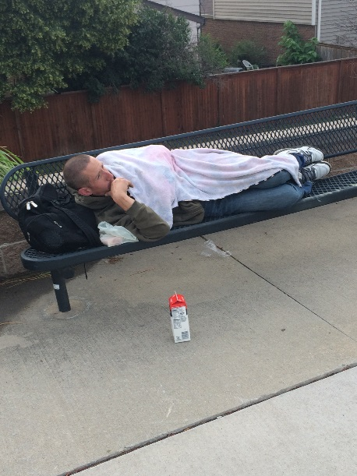
Highline Canal

Slide 10
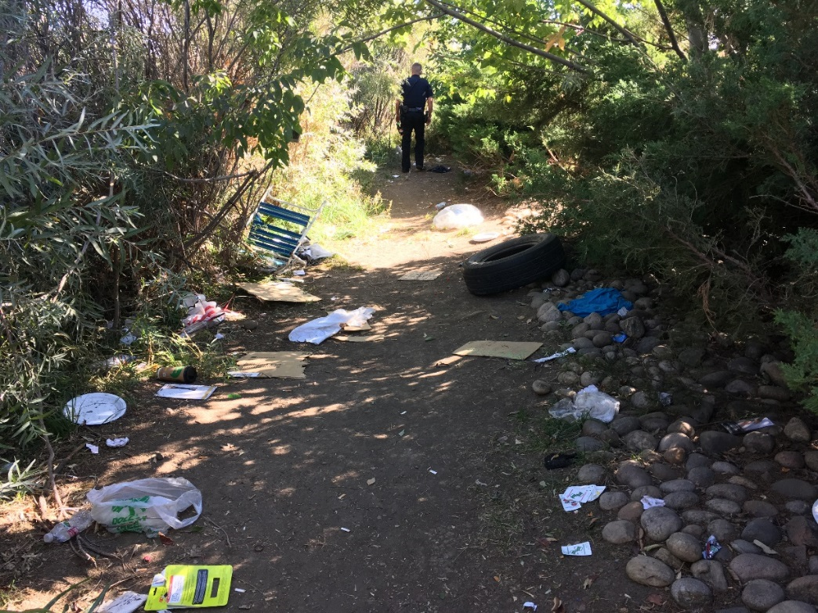
Ramada Inn

Slide 11
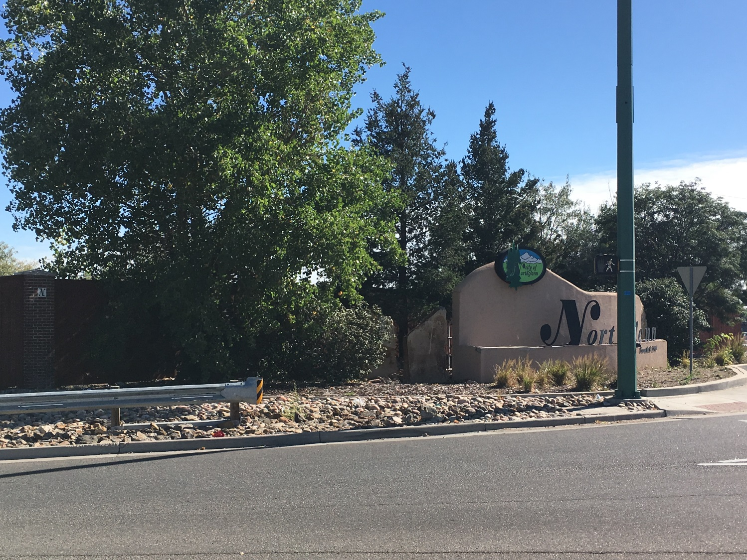
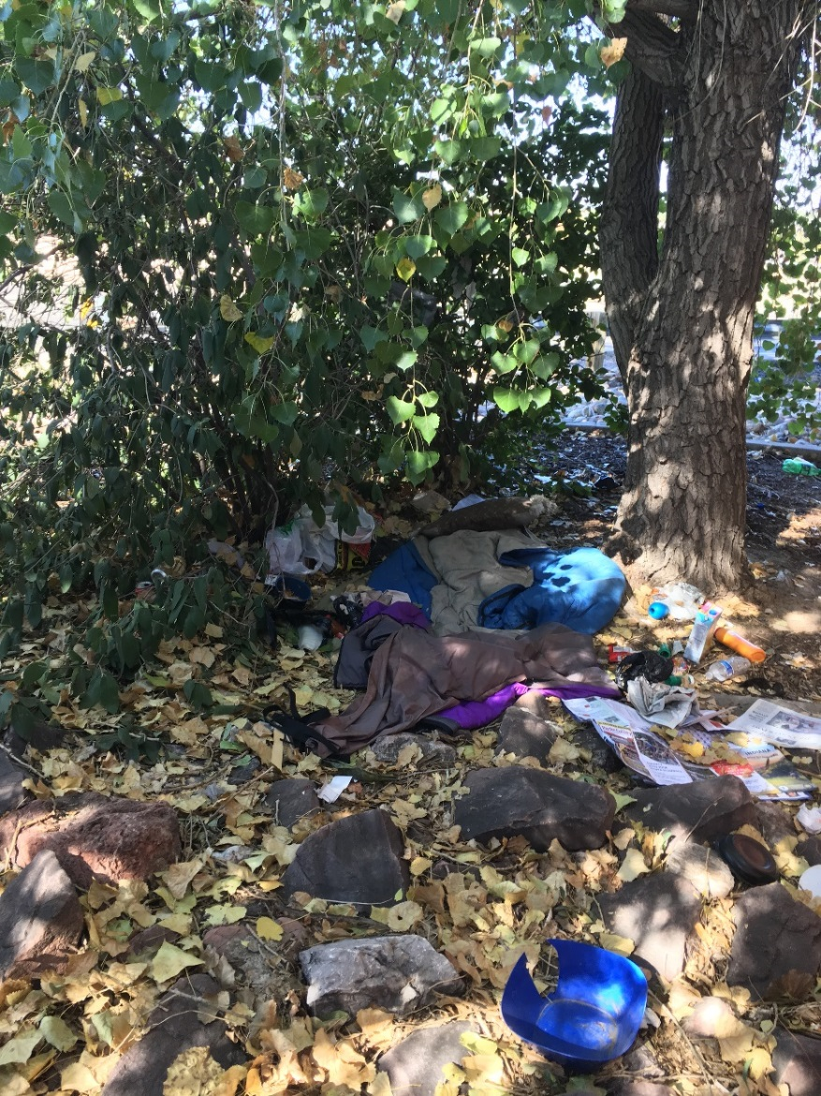
104th Ave & I-25

Slide 12
Illegal Activities
Chronic Public Intoxication
Panhandling
Loitering & Encampments
Criminal Activity (Theft, Break-Ins, Trespassing, etc.)
Illegal Drugs
Disorder & Disturbances
Medical Calls
Public Health (Sanitation and Disease)
Notes:
There are genuine concerns surrounding Transient Populations and the impact they have on the community around us. Here a just a few. Northglenn and the surrounding municipalities have seen increases in many of these categories to include recent transient homicides and sexual assaults.
Since 2016 the Police Department has written 21 camping ordinance violation summons and only three “panhandling” summons. Enforcement is not the answer.

Slide 13
What can we do legally?
Notes:
1st Amendment allows citizens the right to free speech which include the right to ask for money in public areas.
Private Property – Enforcement must be supported by the landlords or property owners. Pre-authorization is helpful.
Ordinance violations often require warnings and are often minor in nature.

Slide 14
What are your concerns?

Slide 15
Location
Crime Triangle
Victim
(Community)
Offender
(Transient)
Notes:
If we were to apply the “Crime Triangle” methodology to this problem, it might afford us some possible solutions to help mitigate the problem.

Slide 16
Location (Solutions)
Crime
Triangle
Apply CPTED concepts to the identified encampments or loitering areas to decrease the problems caused by them:
Tree and Brush Mitigation
Create sustainable low maintenance vegetation areas
Displace the encampments from being conveniently located near retail areas and highway interchanges
Create MOUs with stakeholders (Highline Canal, Ramada, CDOT, etc.)
Noise Deterrent Devices (Mosquito)
Increased Lighting
Surveillance Systems
Water Sprinklers
No Trespassing Signage & Pre-Authorization for Police
Consistent policies
No tolerance approach to criminal behavior

Slide 17
Businesses - Take Action
Lights
Landscape
Access
“No Trespassing” signs
“Patron only” signs
Enable vs Help
Proactive vs. Reactive
“Let us not criminalize”
Notes:
Over the last two years the North Metro Area has seen an increase Transient Populations and the Police Department has identified close to 200 individuals identified as Transients. We have also talked with local business owners, citizens and other Public Service providers that have seen an increase in their Transient related calls for service.
One local business owner recently stated they will move their business from the Safeway Shopping Center when her lease expires unless something is done about the transients because they are driving away her business and her customers don’t feel safe. She expressed that the chronic intoxication, defecation, urination, drug and prostitution concerns are endless.

Slide 18
Victims (Community)
Crime
Triangle
Solicit Input and Participation
Education Programs for Police, City Staff, Local Businesses and Residents
Explore Available Resources
Create Partnerships
Assess Progress

Slide 19
Offender (Transients)
Crime
Triangle
Resources and Referral
Mental Health and Addiction Resources
Structured Camping Facilities
Work and Low Income Housing Opportunities
Increase Enforcement
Law or Ordinance Changes
Providing Day Resource Centers

Slide 20
The Problem
It won’t just go away
Must be sustainable and impactful
Must have the best interest and support of the Community
How can you be part of the Solution?
Pro-Active Northglenn Task Force

